Slide 1

Bank of America
MIS - 636 B
Data Warehousing / Business Intelligence
Prof. Joseph Morabito
Team - 2
Rahul Saini | Kunal Batra | Rucha Patil Krishna Lala | Isha Goyal | Bhumika Patoliya

Slide 2
Table of Content
History
Problem Statement
High Level Bus Matrix
Opportunity Matrix
Design Dimensional Model
Detailed Bus Matrix
Prioritization Grid
Logical Fact Table
Aggregate Table
Changing Dimensions
OLAP Cube - Slicing and Dicing, Drill Down Approach
BI Portal and Dashboards
User and Task Analysis
References
Rucha Patil

Slide 3
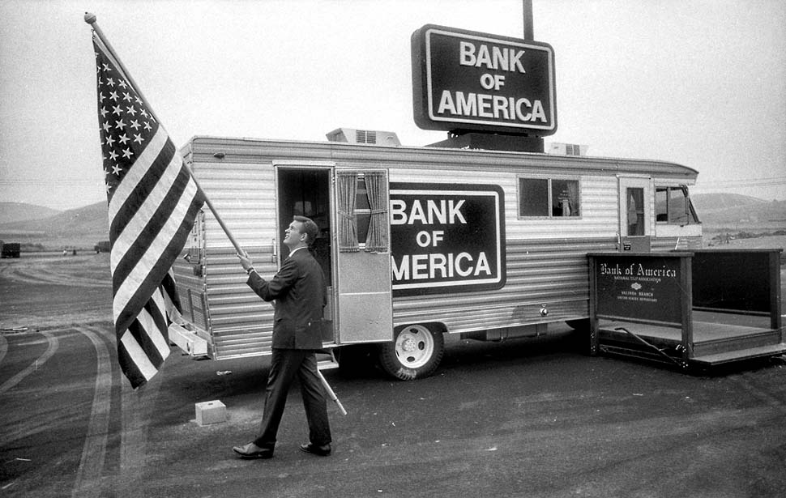
Our History
Bank of America Corporation(BofA)is an American multinational financial services organization headquartered in Charlotte, North Carolina.
It is positioned 2nd on the rundown of largest banks in the United States by assets.
As of 2016, Bank of America was the 26th largest organization in the United States by total revenue.
Bank of America wealth management organizations, with client balances of roughly $2.5 trillion, provide tailored solutions to meet client needs through a full set of investment management, brokerage, banking, trust and retirement products.
Rucha Patil

Slide 4

Problem Statement
Where did Bank of America clients deposits the most cash till previous year?
Which city has the most branches?
Which branch has seen the most growth in last few decades?
How Bank of America bank network grow in last decade?
Rucha Patil

Slide 5
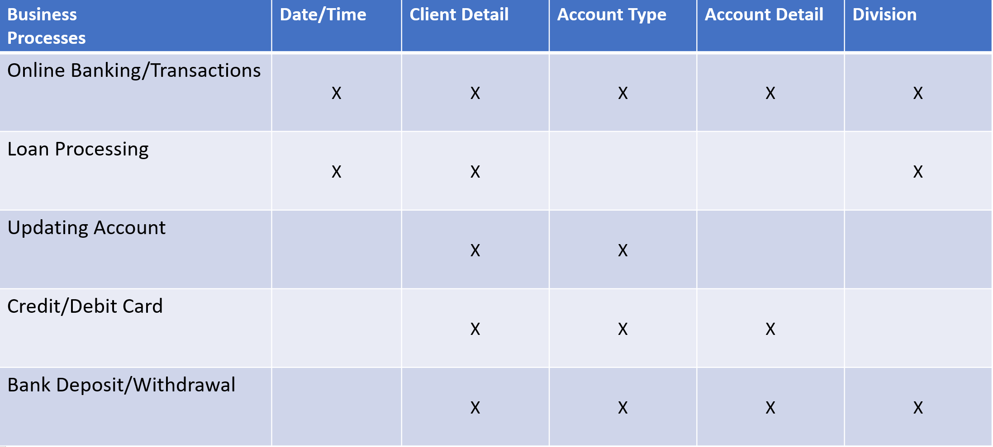
High Level Bus Matrix
Isha Goyal
Notes:
Bus matrix identifies key business processes of an organisation along with associated dimensions.
Business process - Rows
Dimensions-columns
Cell of matrix is marked to indicate which dimensions apply to which processes

Slide 6
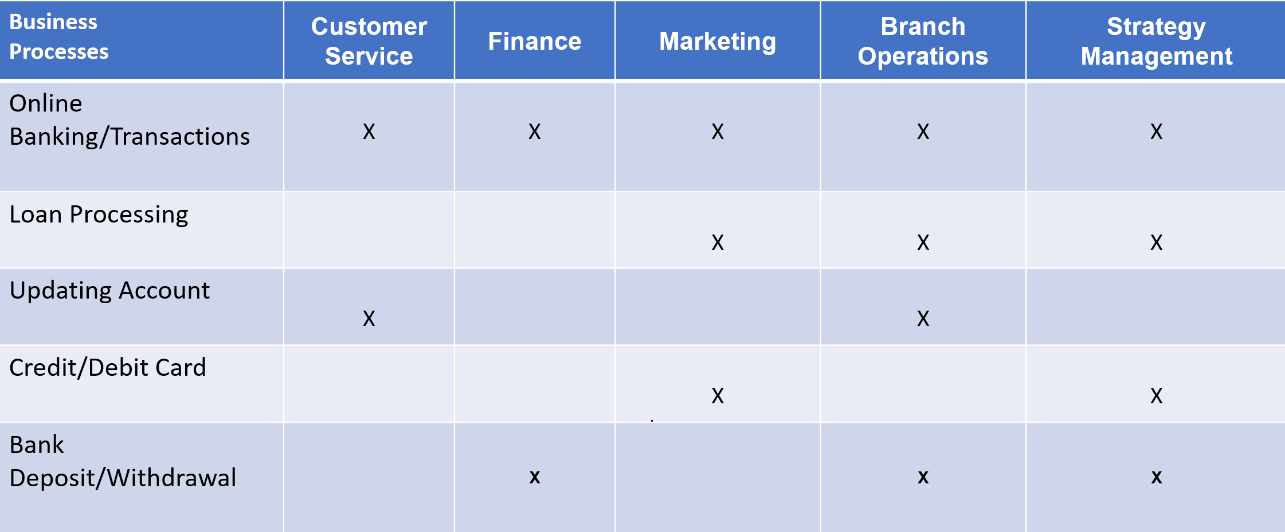
Opportunity Matrix
Isha Goyal
Notes:
Dimension columns are replaced by business functions.
Matrix cells indicate which business functions are interested in which business process.
This helps to identify which business groups should be invited for collaborative design sessions for each process-centric rows.

Slide 7
Design Dimensional Model
Step 1 - Choose the Business Process
Choose marts on the basis of a balanced design
Urgency and complexity of user requirements
Accessibility of source data
Political considerations
Funding sources
Step 2 - Declare the Grain
Declaring the grain is equivalent to saying what is the individual fact table record
Tip - The grain should be the same as exists in the operational systems so choose the lowest grain possible.
Step 3 - Choose the Dimension
The grain is stated in terms of the primary dimensions.
All dimensions from the matrix should be tested.
Design Tip: If the dimension doesn’t match the declared grain, you have two choices:
Drop the dimension from consideration
Change the grain declaration
Step 4 - Choose the Facts
Add as many facts as possible within the context of the grain.
Resist adding facts with different grains to the same fact table.
A fact may exist in more than one fact table
For every fact, consider the aggregation rules
Rahul Saini

Slide 8
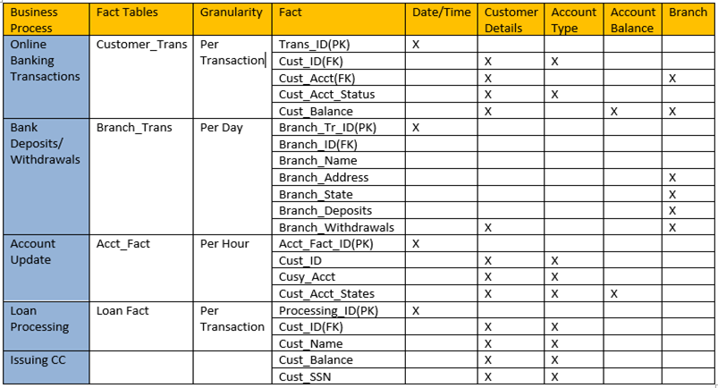
Detailed Bus Matrix
Rahul Saini

Slide 9
Prioritization Grid
HIGH
BP1
BP2
BP4
BP5
BP1
Online Banking Transaction
BP3
BP2
Bank Deposit / Withdrawal
BUSINESS IMPACT
BP3
Account Update
BP4
Loan Processing
BP5
Issuing Credit Card
LOW
FEASIBILITY
HIGH
Rahul Saini
Notes:
Aligning Business and IT on Big Data Journey

Slide 10
Fact Tables
Fact tables contain a composite primary key making it a unique identifier per event
Fact tables express many-to-many relationships between tables
Numerical fact attributes are also called measure, wich provide useful information such as dollars in a bank account
In a star-schema the fact table is the center hub, and is surrounded by multiple dimensional tables
In fact tables and dimensional tables, relationships are symmetrical
Krishna Lala

Slide 11
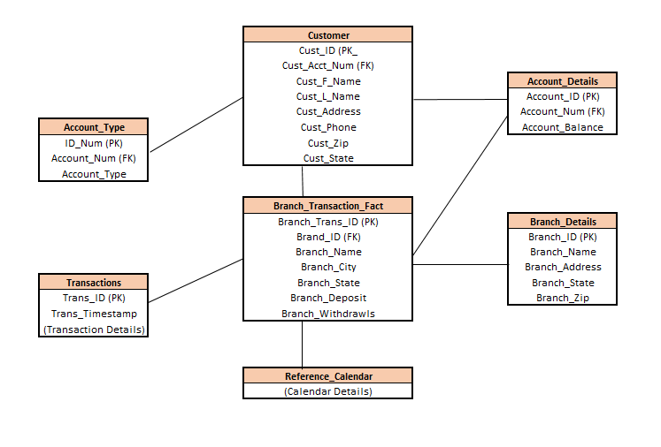
Logical Fact Table
Krishna Lala

Slide 12
Aggregate Tables
Aggregate fact tables are numeric rollups of the fact table data
They are used to accelerate query performance
Aggregate fact tables should be readily available so that BI tools can easily choose the aggregate level at the time of query building - This is known as Aggregate Navigation
Aggregates should behave like database indexes to speed up the query process
Ex: A senior analyst needs information readily day-over-day, a data source that has already been created would just need to be ‘run’ to quickly obtain that data.
Think of, “How fast can I create a spreadsheet with high-level information to a CEO?”
Building an aggregate table would speed this up
Krishna Lala

Slide 13
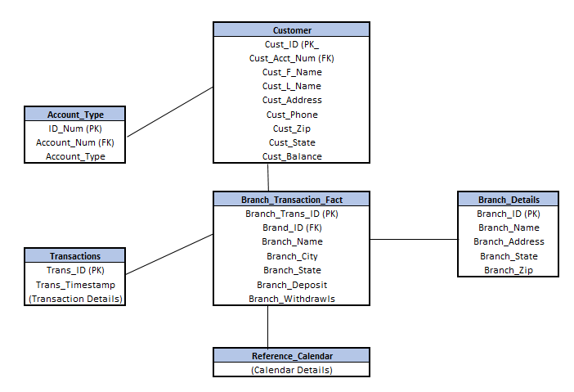
Aggregate Tables
Note that account details were removed to create a more high-level overview.
Not as detailed as the fact tables seen earlier
Krishna Lala

Slide 14
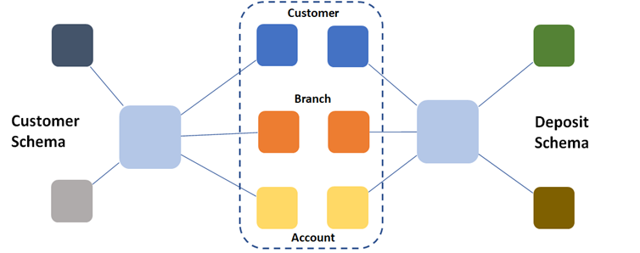
Conformed Dimensions
A conformed dimension is a dimension that has exactly the same meaning and content when being referred from different fact tables.
In our data warehouse, following dimensions are conformed:
a) Customer dimension
b) Branch dimension
c) Account dimension
These dimensions are described in the same way across the data warehouse, ensuring consistent reporting across the enterprise.
Bhumika Patoliya

Slide 15
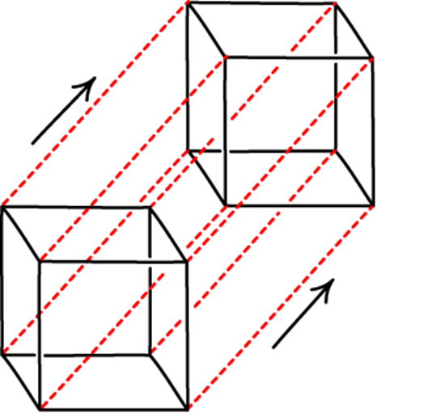
Slowly Changing Dimensions
A Slowly Changing Dimension (SCD) is a dimension that stores and manages both current and historical data over time in a data warehouse.
Type 1 SCD: Overwriting
Example: Updating Customer Balance
In this scenario, the older value having customer’s previous balance would be deleted and a new value with the new balance would be inserted.
Type 2 SCD: Creating Another Dimension Record
Example :Updating Customer’s Branch
In this scenario, once the customer moves account from one branch to another, a new record would be added with flag set to ‘Y’ for the new branch while the old branch’s record would be set to ‘N’.
Bhumika Patoliya

Slide 16

Cube Approach
The cube approach quite helping in understanding and reporting data for various factors
In our approach, each block signifies total deposits done in a particular year in a particular state for a particular deposit type.
As a result, cube approach helps in reporting data for various levels of granularity.
Furthermore, the cube approach helps in answering questions from our problem statement like “Where did Bank of America clients deposits the most cash till previous year?”.
Bhumika Patoliya

Slide 17
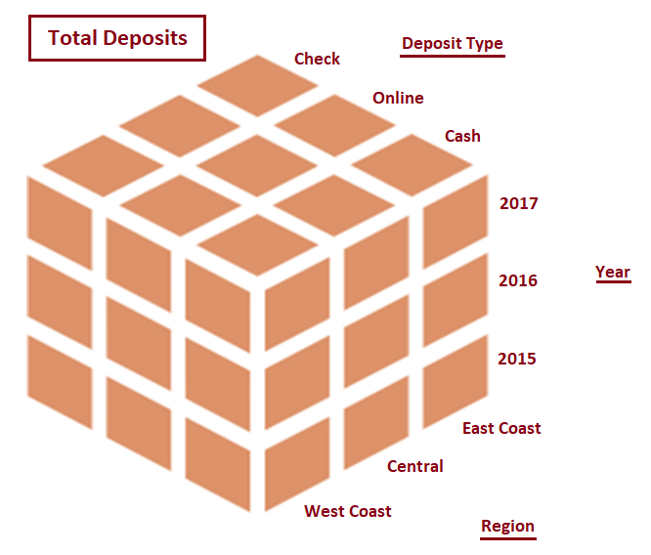
Cube - Drill Down Approach
Drill Down allows the user to navigate among levels of data ranging from the most summarized (up) to the most detailed (down).
Bhumika Patoliya

Slide 18
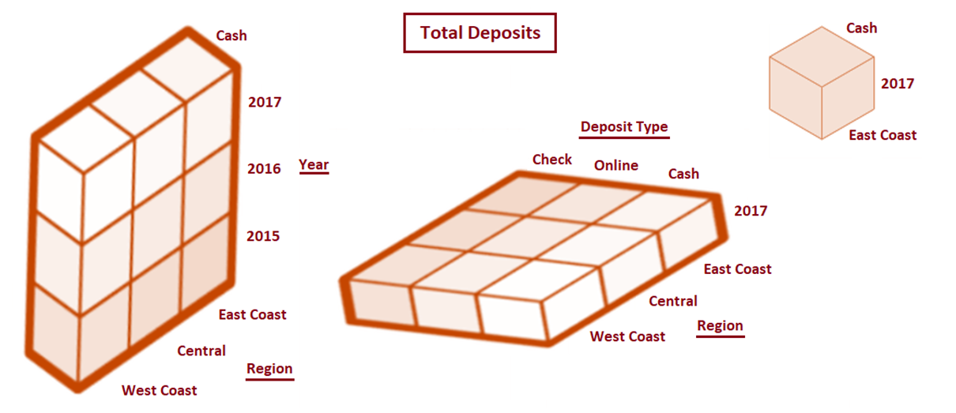
Cube - Slicing and Dicing
Bhumika Patoliya

Slide 19
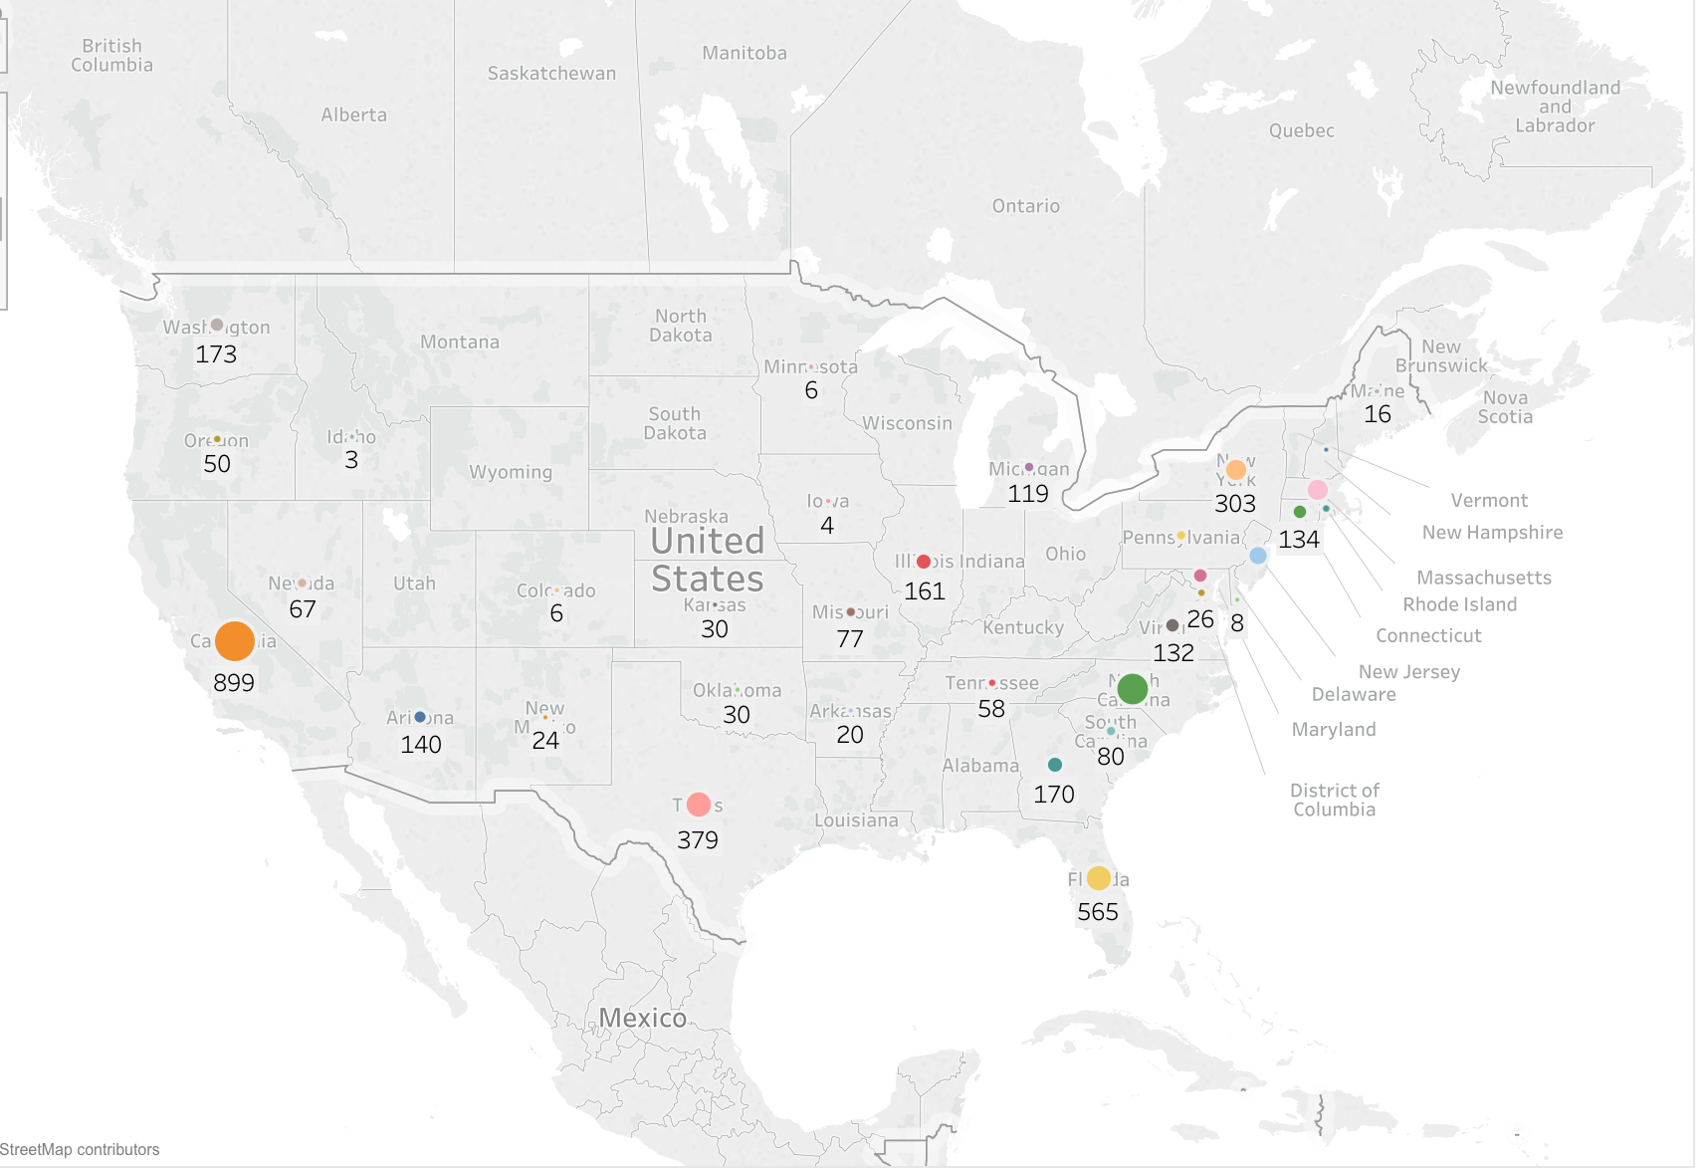
BI Portals and Dashboards
Kunal Batra

Slide 20
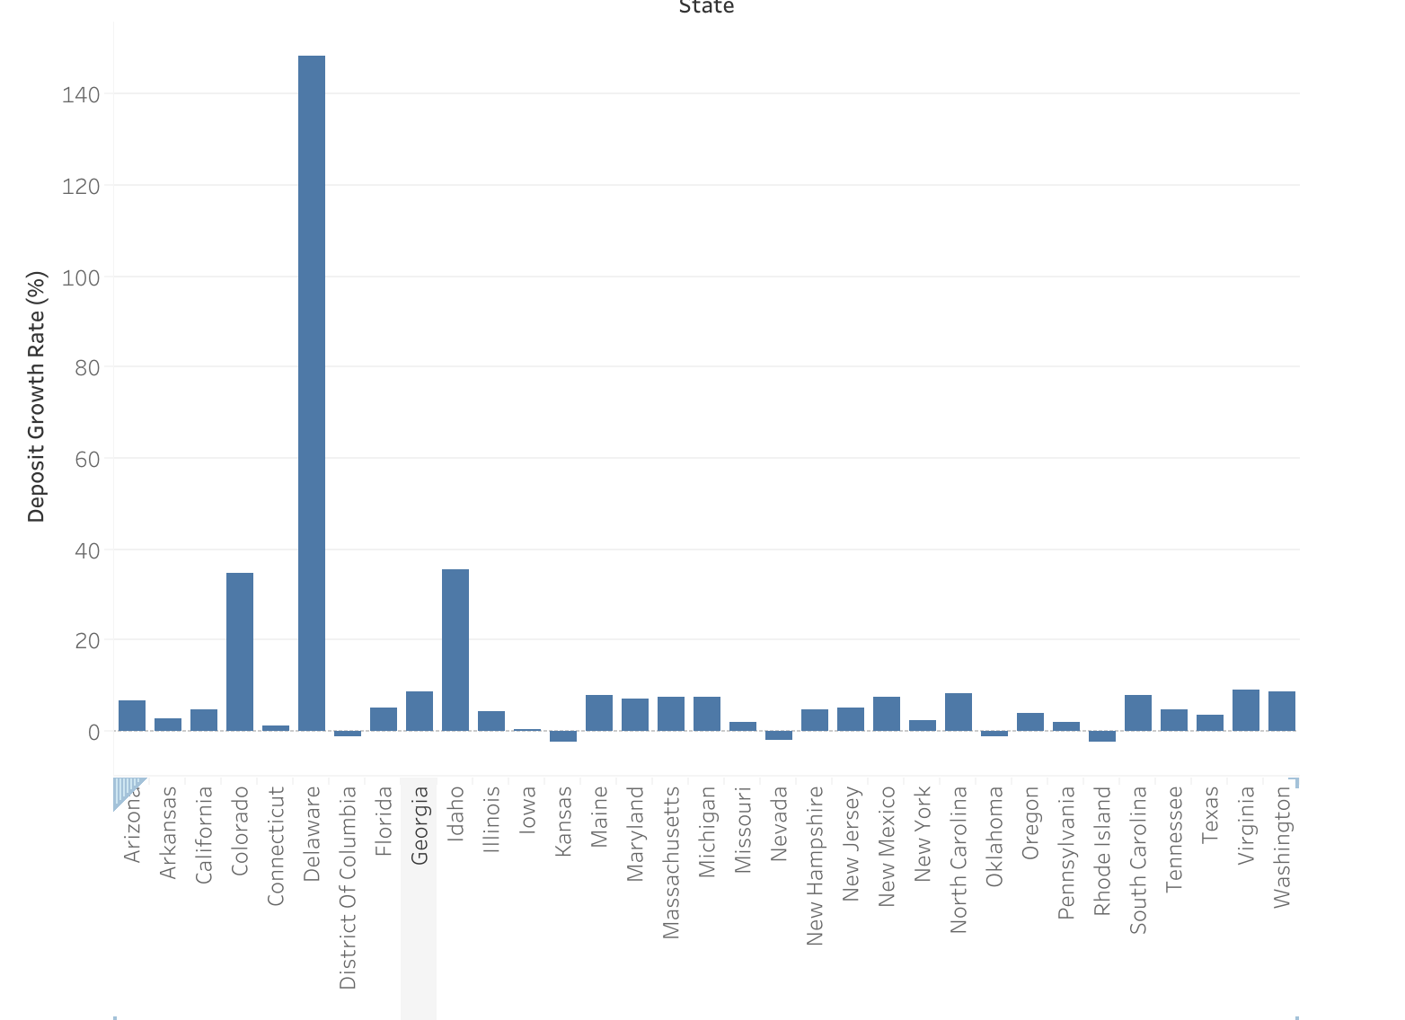
BI Portals and Dashboards
Kunal Batra

Slide 21
BI Portals and Dashboards
Data set is obtained from FDIC. It was clean data with no missing values.
The graph above shows the number of branches of BOA throughout US.
California being on top followed by Florida, Texas and New York.
Colored dots represent the deposits in these states.
North Carolina being state with head office has high deposit rates.
Kunal Batra

Slide 22
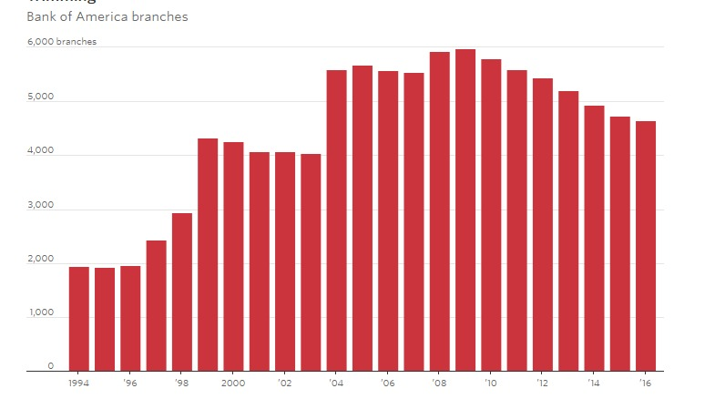
BI Portals and Dashboards
Kunal Batra

Slide 23
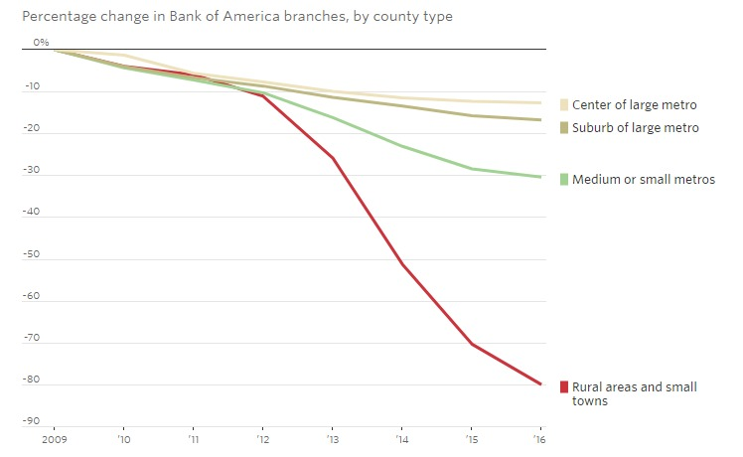
BI Portals and Dashboards
Kunal Batra

Slide 24
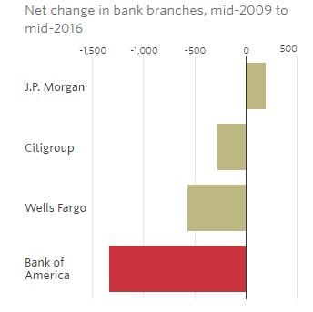
BI Portals and Dashboards
Kunal Batra

Slide 25
BI Portals and Dashboards
The above graphs are about total number of branches open or closed in the last 10 years.
The number of branches were highest in 2009.. There were total 6185 branches.
Currently as per 2017 data, the total number of branches have been reduced to 4594 as compared to 4672 in 2016.
Highest decline is observed in Rural areas.
Similar trend can be seen in all the other banks except JP Morgan.
Kunal Batra

Slide 26
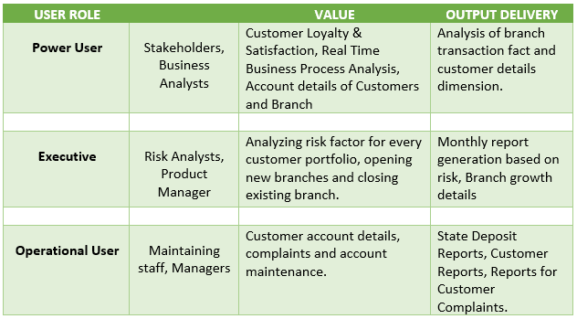
User and Task Analysis
Task analysis is the process of learning about ordinary users by observing them in action to understand in detail how they perform their tasks and achieve their intended goals.
Kunal Batra

Slide 27
References
https://about.bankofamerica.com/en-us/who-we-are.html#fbid=U1_DdcFLhtI
https://www.fdic.gov/ (For Data)

Slide 28
Thank you !!!

